Slide 1

CMSC 137
Data Communications and Networking
Lecture Module
07 – Digital Transmission

Slide 2
Module 7: Digital Transmission
Rozano S. Maniaol
Lecturer

Slide 3
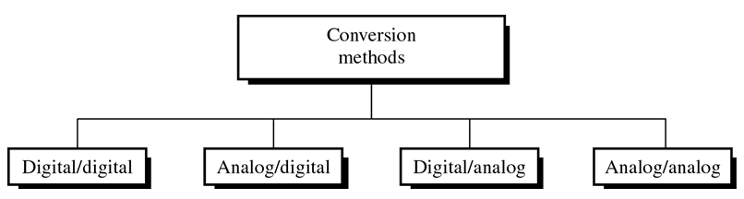
Introduction
A computer network is designed to send information from one point to another. The information needs to be converted to either digital signal or analog signal for transmission.

Slide 4
Digital to Digital Conversion

Slide 5
Digital to Digital Conversion
Represent digital data by using digital signals
Involves 3 techniques:
  Line Coding
  Block Coding
  Scrambling
Line coding is always needed; block coding and scrambling may or may not be needed

Slide 6
Line Coding

Slide 7
Definition
Data Element
  Smallest entity that can represent a piece of information (bit)
Signal element
  Shortest unit (timewise) of a digital signal
Ratio “r” is the number of data elements carried by each signal element

Slide 8
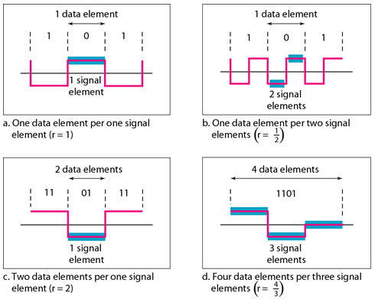
Signal Element vs Data Element

Slide 9


Definition
Data Rate (Bit Rate)
  Number of bits sent in 1 second (bps)
Signal Rate (Pulse Rate, Modulation Rate, Baud Rate)
  Number of signal elements sent in 1 second (baud)
Goal: Increase data rate (increase speed) while decreasing signal rate (decrease bandwidth requirement)

Slide 10
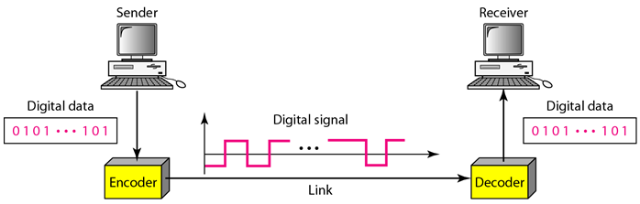
Line Coding
Process of converting digital data (strings of 0s and 1s) into digital signal

Slide 11
Considerations for choosing good coding scheme
Effective Bandwidth
  Finite compared to Absolute Bandwidth
  Baud rate determines the required bandwidth
  For now, Bandwidth is proportional to Baud Rate

Slide 12
Considerations for choosing good coding scheme
Baseline Wandering
  Receiver calculates a running average of the received signal power – baseline
  Incoming signal is evaluated against baseline (to determine 1 or 0)
  Long sequence of 0's or 1's can cause a drift in the baseline
  Line coding scheme must prevent this

Slide 13
Considerations for choosing good coding scheme
Direct Current (DC) Components
  Very low (near zero) frequencies created by the spectrum when digital signal is constant for a while
  Some systems cannot pass low frequencies
  Some systems use electrical coupling
  No DC component is desired

Slide 14
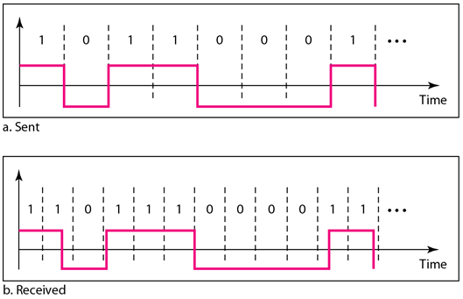
Considerations for choosing good coding scheme
Self-synchronization
  Digital signal includes timing information in the data being transmitted

Slide 15
Considerations for choosing good coding scheme
Built-in Error Detection
  Signal has built-in error detection
Immunity to Noise and Interference
  Signal generated is immune to noise
Complexity
  Scheme should be simple; the more robust and resilient the code, the more complex it is to implement and the price is often paid in baud rate or required bandwidth

Slide 16
Line Coding Schemes
Unipolar – all signal levels are above or below time axis
Polar – signal levels are on both sides of the time axis
Bipolar – three levels: positive, negative, zero; one signal level alternates between positive and negative
Multilevel – increase number of bits per baud
Multitransition – more than 2 transition rules

Slide 17
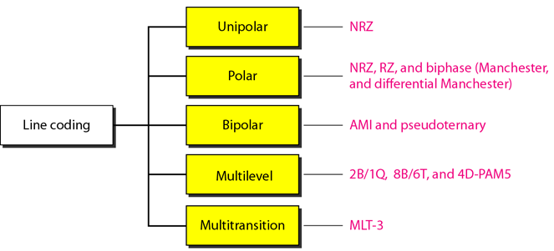
Line Coding Schemes

Slide 18
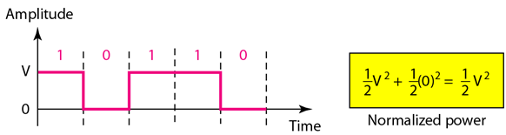
Unipolar NRZ
Non-Return-to-Zero
1 – positive voltage, 0 – zero voltage
Scheme is prone to baseline wandering and DC components. It has no synchronization or any error detection. It is simple but costly in power consumption

Slide 19
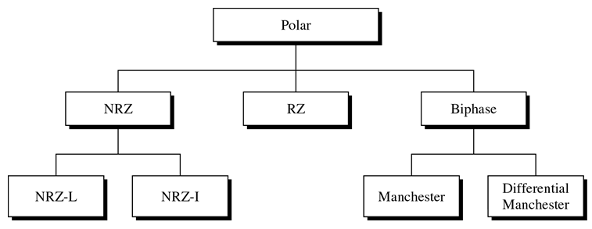
Polar

Slide 20
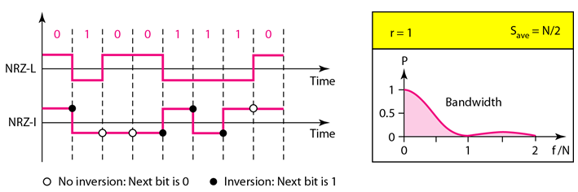
Polar NRZ
NRZ-L (Level)
  Level of voltage determines value of bit
NRZ-I (Invert)
  Change or lack of change in the level of the voltage determines the value of the bit (0 – no change)

Slide 21
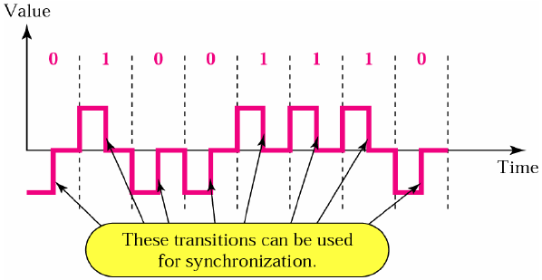
Polar RZ
Midbit transition, solves sync problem of NRZ
More complex, more bandwidth, no DC component or baseline wandering

Slide 22
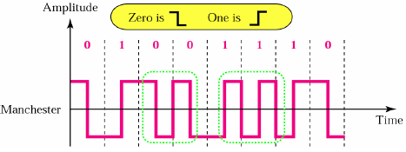
Polar Biphase
Manchester
  inversion at the middle of each bit interval is used for both synchronization and bit representation
  0 = positive to negative transition, 1 = negative to positive transition
  fine for alternating sequence of bits (10101) but wastes bandwidth for long runs of 1s or 0s
  Used by IEEE 802.3 (Ethernet)

Slide 23
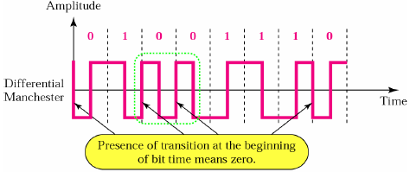
Polar Biphase
Differential Manchester
  inversion at the middle of each bit interval is used for synchronization, presence/absence of additional transition at the beginning of next bit interval identifies the bit
  fine for long runs of 1s but wastes bandwidth for long runs of 0s
  0 = transition, 1 = no transition
  Used by IEEE 802.5 (Token Ring)

Slide 24
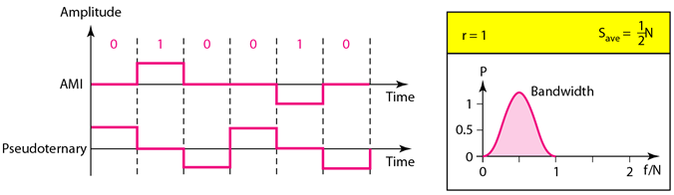
Bipolar
Alternate Mark Inversion (AMI)
  Neutral zero voltage – 0, alternating (+) and (-) - 1
Pseudoternary – reverse of AMI

Slide 25
Multilevel Schemes
Encode a pattern of m data elements into a pattern of n signal elements
If 2^{m} > L^{n}, we cannot represent data elements since not enough signals
mBnL, pattern of m data elements is encoded in a pattern of n signal elements in which 2^{m} <= L^{n}
L = B for binary, T for ternary (3 levels), Q for quaternary (4 levels)

Slide 26
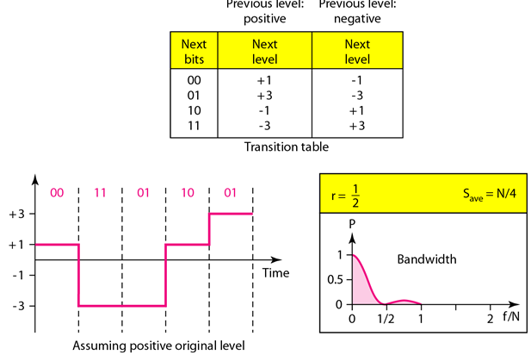
2B1Q
Two binary, one quaternary
Used in DSL (Digital Subscriber Line)

Slide 27
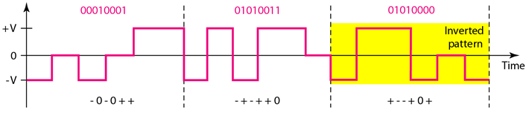
8B6T
Eight binary, six ternary
Used in 100Base-4T, bandwidth 6N/8

Slide 28
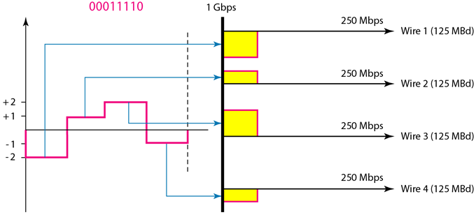
4D-PAM5
Four dimensional five-level pulse amplitude modulation
Used in Gigabit LANs, uses 4 wires

Slide 29
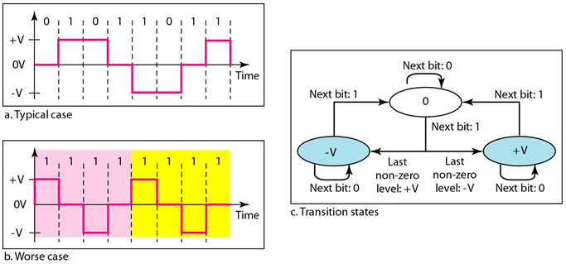
Multitransition: MLT3
Uses 3 levels (+V, 0, -V)
Uses 3 transition rules to move between levels
  If the next bit is 0, there is no transition
  If the next bit is 1 and the current level is not 0, the next level is 0
  If the next bit is 1 and the current level is 0, the next level is the opposite of the last nonzero level

Slide 30
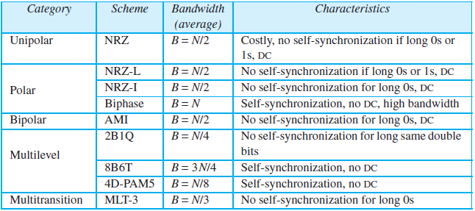
Line Coding Summary

Slide 31
Block Coding

Slide 32
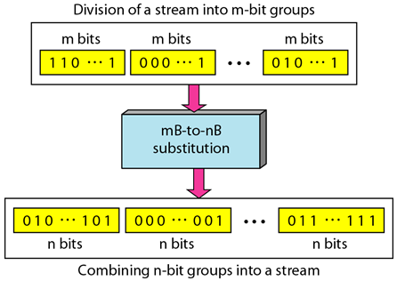
Block Coding
Referred to as mB/nB coding; it replaces each m-bit group with n-bit group
Redundant bit(s) are added to ensure synchronization and error detection
Involves 3 steps: division, substitution and combination

Slide 33
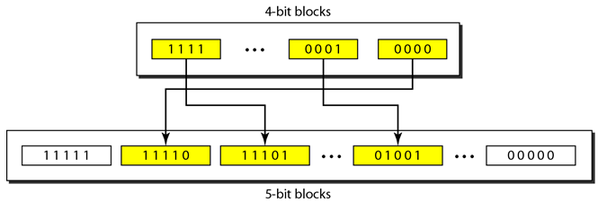
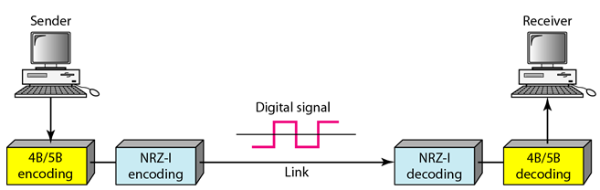
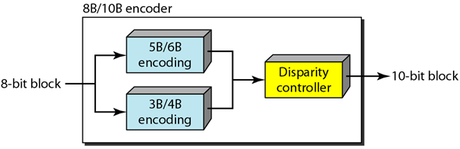
Block Coding Sample
4B/5B (often combined with NZR-I), used in FDDI
8B/10B

Slide 34
Scrambling

Slide 35
Scrambling
The best code is one that does not increase the bandwidth for synchronization and has no DC components
Bipolar AMI is most suitable for long distance transmission but long sequence of 0s disrupts synchronization
Solution: substitute long sequences of 0s with a combination of other levels
It is implemented at the same time as encoding

Slide 36
B8ZS
Bipolar with 8-zero substitution
Eight consecutive zero-level voltages are replaced by a sequence 000VB0VB
  V – non-zero voltage violating the AMI rule
  B – bipolar non-zero voltage
Does not change the bit rate, balances (+) and (-) voltages, substitution may change the polarity of a 1

Slide 37
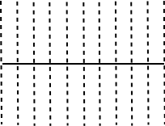
B8ZS
Without scrambling
1
0
0
0
0
0
0
0
0
1
0
0
0
0
0
0
0
0
1
0
0
0
0
0
0
0
0
V
B
B
V
0
0
0
0
0
0
0
0
B
V
V
B
Previous level is positive
Previous level is negative

Slide 38
HDB3
High-density bipolar 3-zero
Four consecutive zero-level voltages are replaced with a sequence of 000V or B00V
Why two sequences? To maintain the even number of non-zero pulses after each substitution
  If the number of nonzero pulses after the last substitution is odd, 000V
  If the number of nonzero pulses after the last substitution is even, B00V

Slide 39
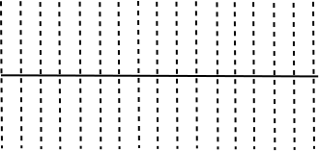
HDB3
1
1
0
0
0
0
1
0
0
0
0
0
0
0
0
0
B
V
B
V
0
0
0
0
0
0
0
0
V
Even
Even
Odd
Even
Even

Slide 40
Analog to Digital Conversion

Slide 41
Analog to Digital Conversion
Digital signal is superior to an analog signal because it is more robust to noise and can easily be recovered, corrected and amplified
Tendency today is to change analog signal to digital data (digitization)
2 common techniques:
  Pulse Code Modulation (PCM)
  Delta Modulation

Slide 42
Pulse Code Modulation

Slide 43
PCM
Consists of 3 steps to digitize an analog signal
  Sampling
  Quantization
  Binary encoding
Before we sample, we have to filter the signal to limit the maximum frequency of the signal as it affects the sampling rate
Filtering should ensure that we do not distort the signal, ie remove high frequency components that affect the signal shape

Slide 44
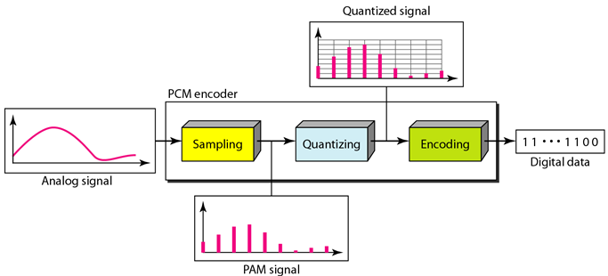
PCM Encoder Components

Slide 45
Sampling
Analog signal is sampled within a certain time period (sampling period or sampling interval T_{s})
Inverse of sampling period is called sampling rate or sampling frequency f_{s}
Process is referred to as Pulse Amplitude Modulation (PAM) and the outcome is a signal with analog (non-integer) values
Sampling rate must be at least twice the highest frequency in the original signal (Nyquist theorem)

Slide 46
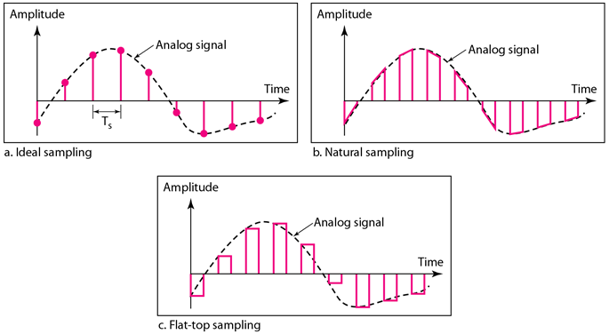
Sampling Methods
Ideal – an impulse at each sampling instant
Natural – a pulse short width with varying amplitude
Flat-top – sample and hold, like natural with single amplitude value

Slide 47
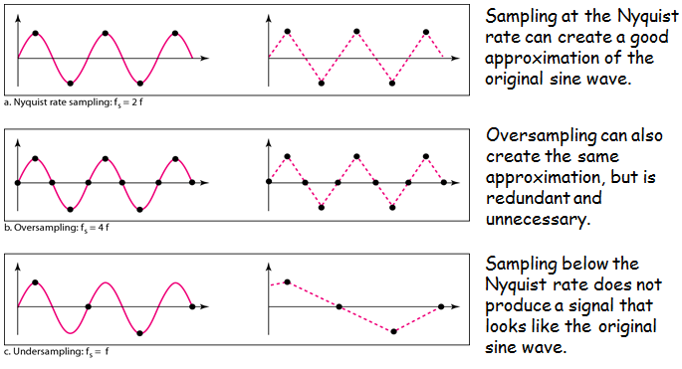
Sampling Rate

Slide 48
Quantization
Sampling results in a series of pulses of varying amplitude values ranging between two limits: v_{min} and v_{max}
The amplitude values are infinite between the two limits and it needs to be mapped onto a finite set of known values
Divide the range into L zones, each of height delta
  delta = (v_{max} – v_{min}) / L
Assign quantized values of 0 to L-1 to the midpoint of each zone
Approximate the value of the sample amplitude to the quantized values

Slide 49
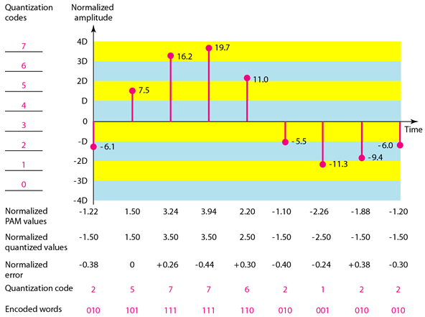
Quantization and Encoding
Assume v_{max} = +20V and v_{min} = -20V
L = 8

Slide 50
Encoding
Each zone is assigned a binary code
Number of bits required to encode the zones is obtained as follows:
Given on the previous example

Slide 51
Bit Rate and Bandwidth Requirement
Bit rate of a PCM signal can be calculated by multiplying the number of bits per sample and sampling rate:
Bandwidth required to transmit this signal depends on the type of line encoding used. A digitized signal will always need more bandwidth than the original analog signal

Slide 52
Question
Question: What is the bit rate needed to digitize human voice assuming 8 bits per sample?
Human voice contains frequency between 0 to 4000Hz
f_{s} = 4000 x 2 = 8000 samples/s
bit rate = 8 x 8000 = 64,000 bps = 64kbps

Slide 53
PCM Decoder
To recover an analog signal from a digitized signal:
  Use a circuit that holds the amplitude value of a pulse till the next pulse arrives
  Pass this signal through a low pass filter with cutoff frequency that is equal to the highest frequency in the pre-sampled signal
The higher the value of L, the less distorted a signal is recovered

Slide 54
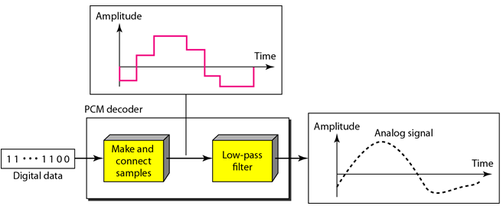
PCM Decoder

Slide 55
Delta Modulation

Slide 56
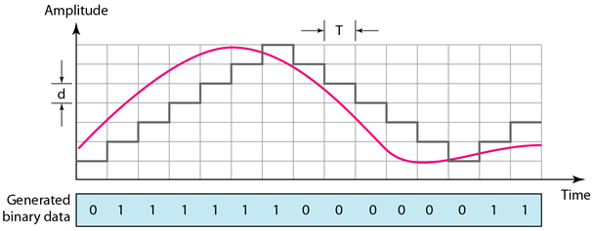
Delta Modulation
This scheme finds the change from the previous sample
If pulse at time t_{n+1} is higher in amplitude than the pulse at t_{n}, a single bit (assume “1”) is used to indicate positive value; if pulse is lower, it results in a negative value (“0”)

Slide 57
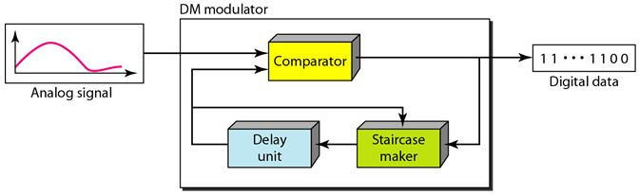
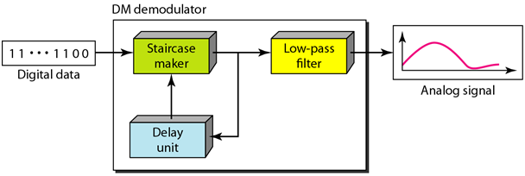
DM Components

Slide 58
Transmission Modes

Slide 59
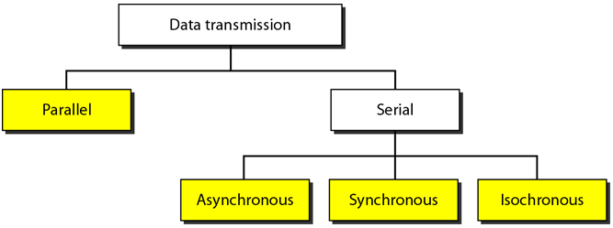
Transmission Modes

Slide 60
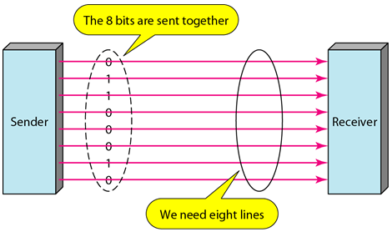
Parallel Transmission
Use n wires to send n bits of data

Slide 61
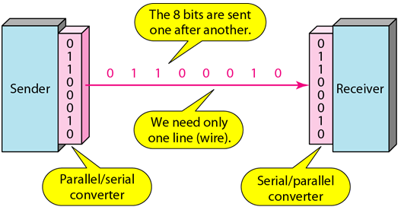
Serial Transmission
1 bit at a time

Slide 62
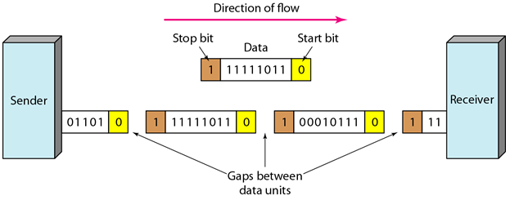
Asynchronous Transmission
Timing of a signal is unimportant
Uses “patterns” - grouping of bit streams into bytes
Start bit (0), Stop bit (1), may have gap in-between
No synchronization at byte level, but present in bit level
Bits can be transferred at random intervals and the data rate of the stream is not required to be constant

Slide 63
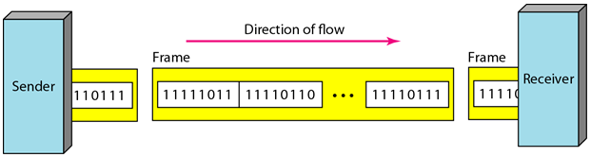
Synchronous Transmission
Bit stream combined into frames which may contain multiple bytes
The receiver is responsible for decoding
Byte synchronization is accomplished in the data link layer
Bits must be transferred in sync with a clock signal

Slide 64
Isochronous Transmission
Combines the features of an asynchronous and synchronous data transfer system
Transmission of bits is fixed with equal gaps
Each transmission begins with a start packet
Used in multimedia data

Slide 65
References
Bucaro, S. Synchronous, Asynchronous, Isochronous. What Does It Mean? Retrieved from http://bucarotechelp.com/networking/basics/88092302.asp
Forouzan, B.A. 2013. Data Communications and Networking, 5th Ed. McGraw-Hill, New York.

